Slide 1
Archetype and Network Analysis
May 5, 2023

Slide 2
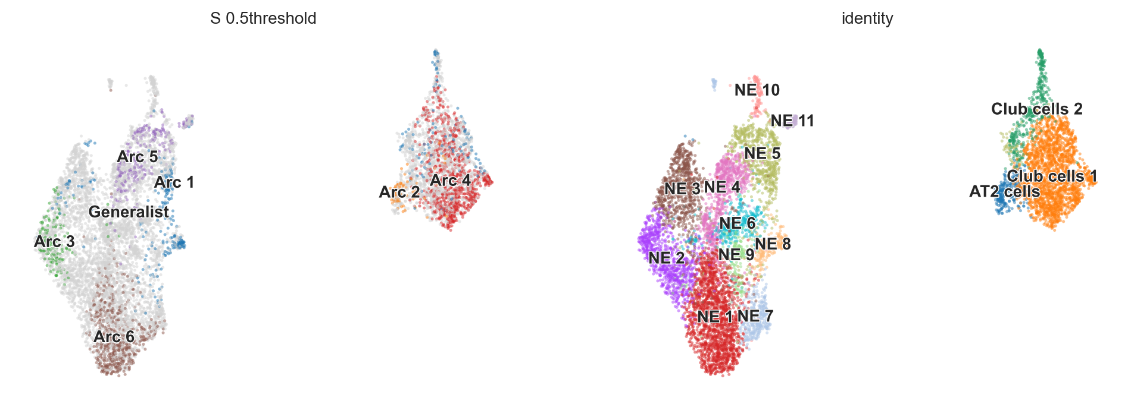
6 archetypes define TKO heterogeneity

Slide 3
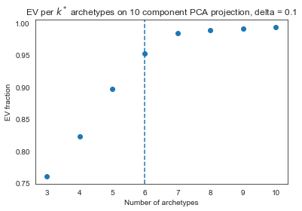
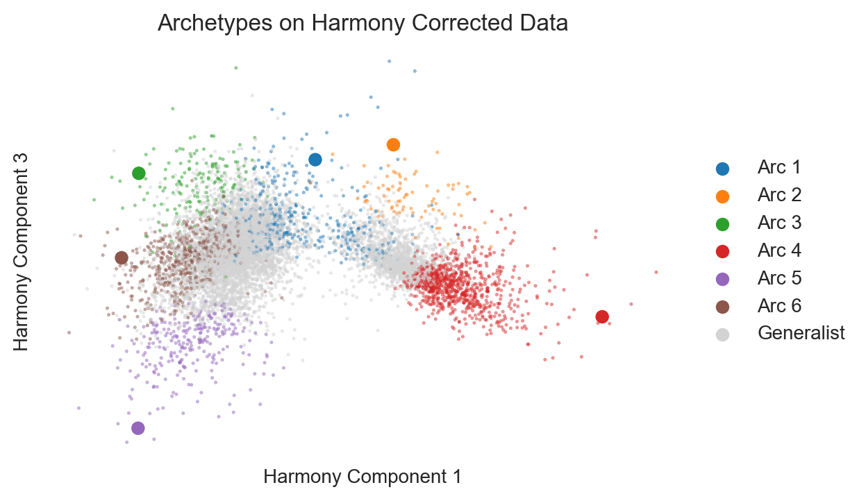
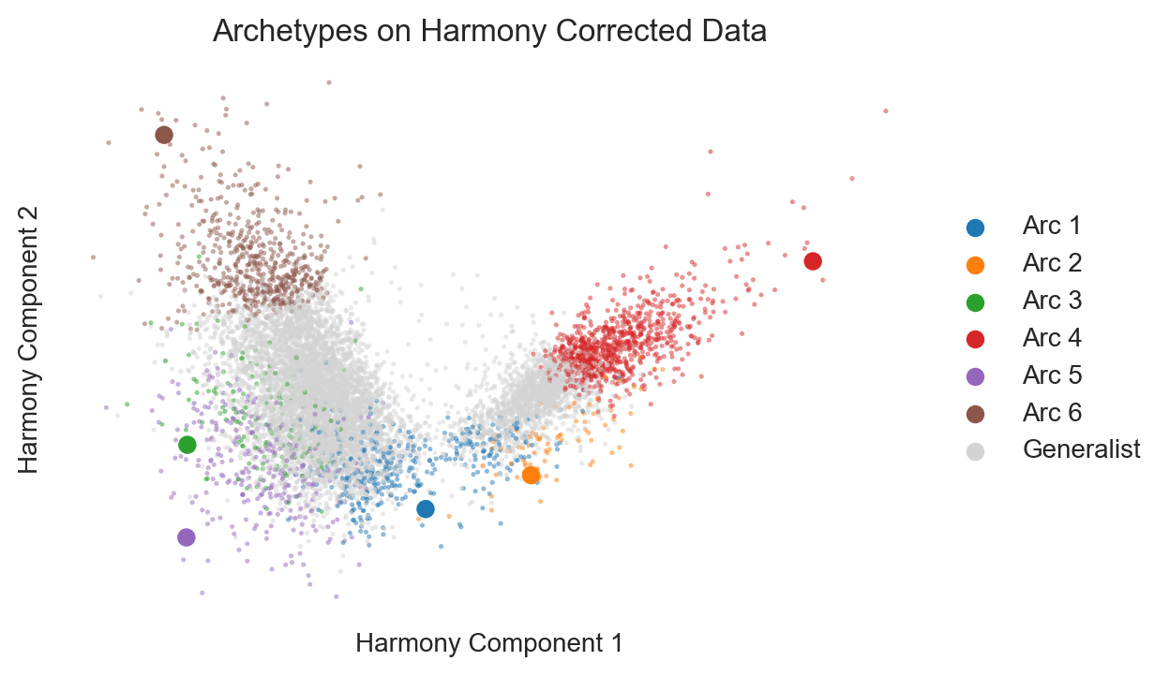
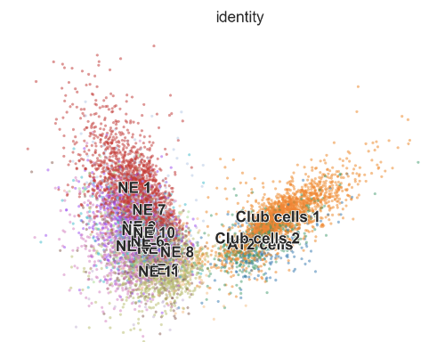
Choosing 6 archetypes
Harmony reduction shows that archetypes find extremes of the data and better characterize the heterogeneity of the NE cells than clustering
Specialists are defined as archetype score > 0.5.

Slide 4
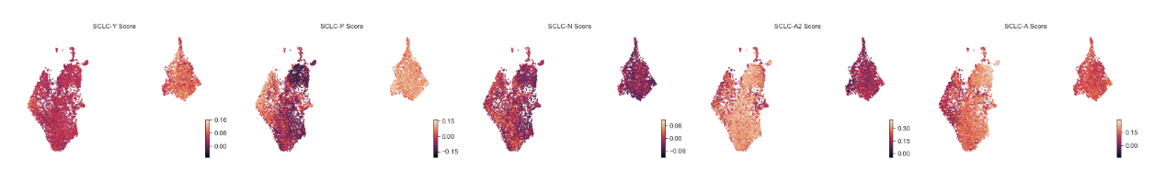
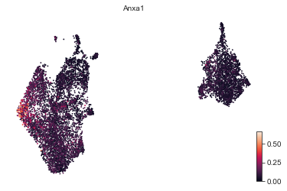
Characterizing the archetypes
Supervised AA shows that the classic SCLC subtypes don’t totally capture the NE heterogeneity here
Archetype 3 is slightly higher for P, due mainly to ANXA1 expression
Most NE subtypes have higher A2 score; Archetype 5 is slightly higher for A
No N signature
The non-NE cells aren’t very high for the Y signature

Slide 5
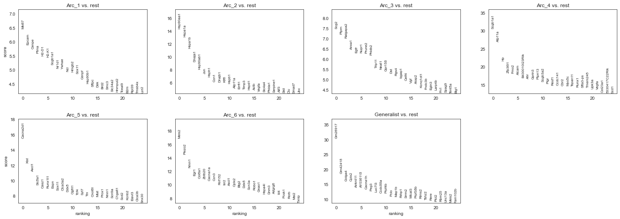
Characterizing the NE archetypes

Slide 6
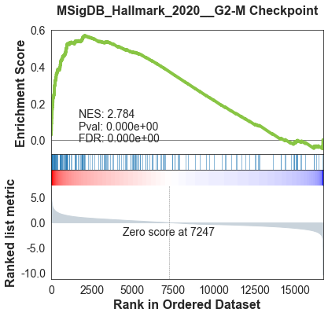
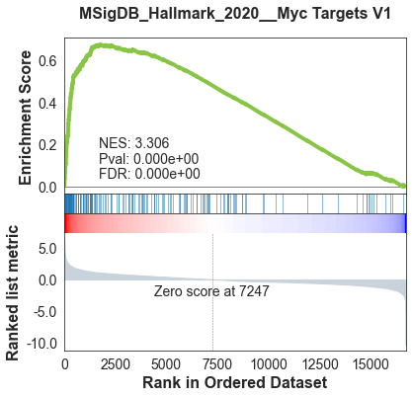
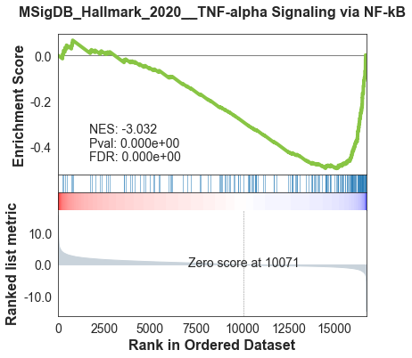
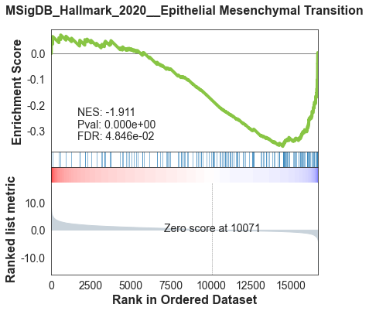
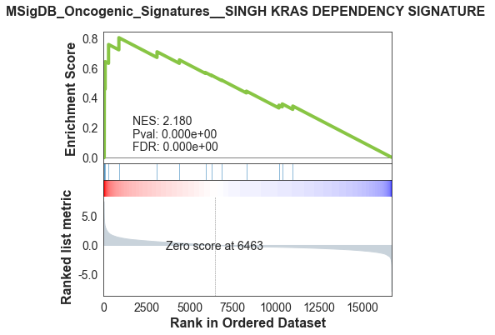
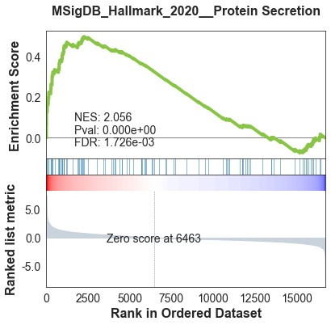
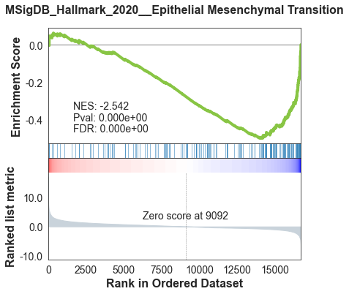
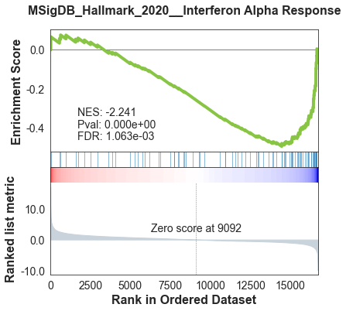
Characterizing the NE archetypes
Arc 1
Arc 3
Arc 5
Arc 6

Slide 7
Characterizing the NE archetypes
Arc 1
Arc 3
Arc 5
Arc 6

Slide 8
Characterizing the NE archetypes
Arc 1
Arc 5

Slide 9
Characterizing the NE archetypes
Arc 3
Arc 6

Slide 10
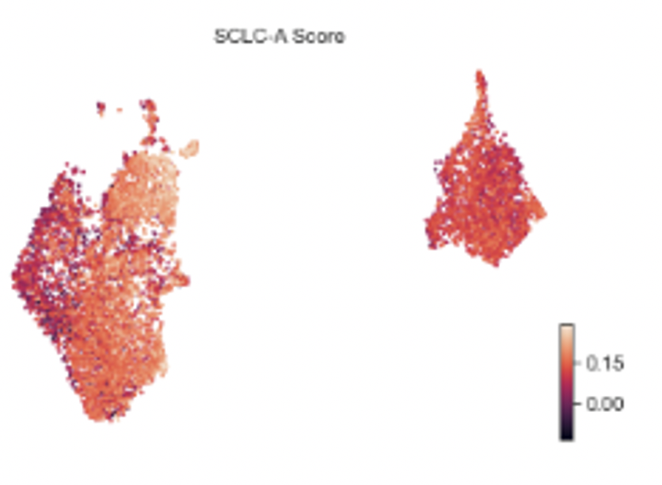
Archetype 5
↑ NE and NPC gene sets
↑ NFIB up and FOXA1 down-associated genes
↓ TNFa, EMT, stress, and interferon
More A-like
Archetype 4
Non-NE, Club cell-like
Archetype 3
Slightly enriched for P due to ANXA1+
↑ hypoxia and stress, KRAS dependency, and protein secretion
Archetype 2
Non-NE, AT2-like
Archetype 1
Bridge between NE and non-NE states
↑ pEMT, cycling, G2M checkpoint, oxphos
↓NE gene set
Archetype 6
↑ NE gene set, NFIB up and FOXA1 down-associated genes
↓ EMT, interferons, met score
MEIS2 and ASCL1 +
More A2-like

Slide 11
Summary of archetype characteristics
Arc 1
Bridge between NE and non-NE states
GSEA enrichment of pEMT, Cycling, G2M checkpoint, oxphos enrichment
Enriched for EPCAM
Downregulates NE gene set
Arc 2
Non-NE, AT2-like
Arc 3
Slightly enriched for P due to ANXA1+
Enriched for hypoxia and stress, KRAS dependency, and protein secretion
Arc 4
Non-NE, club cell-like
Arc 5
Downregulates TNFa, EMT, stress, and interferon
Upregulates NE and NPC gene sets
Upregulates NFIB up and FOXA1 down-associated genes
More A-like
Arc 6
Upregulates NE gene set
Upregulates NFIB up and FOXA1 down-associated genes
Downregulates EMT and interferons
MEIS2 and ASCL1 +
More A2-like

Slide 12
Supplemental information
While this was run on the Harmony batch-corrected data, I did run AA on each sample individually as well
Collectively, these found the same archetypes
M1 had 6 archetypes (3 NE, 3 non-NE)
M2 had 5 archetypes (3 NE, 2 non-NE)

Slide 13
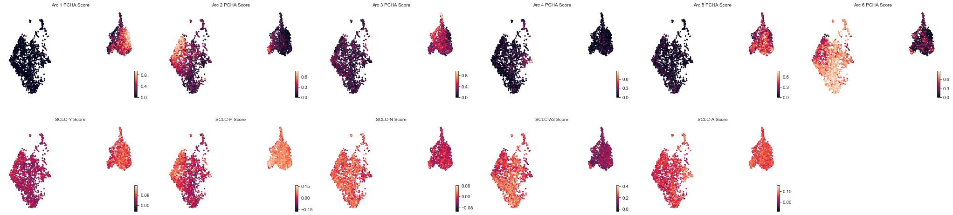
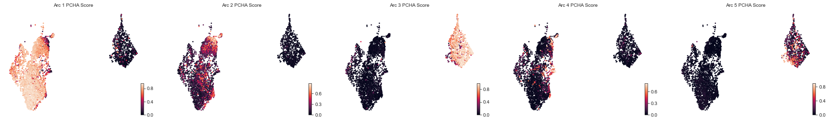
M1 Archetypes
M2 Archetypes

Slide 14
M1 and M2 archetypes on combined UMAP

Slide 15
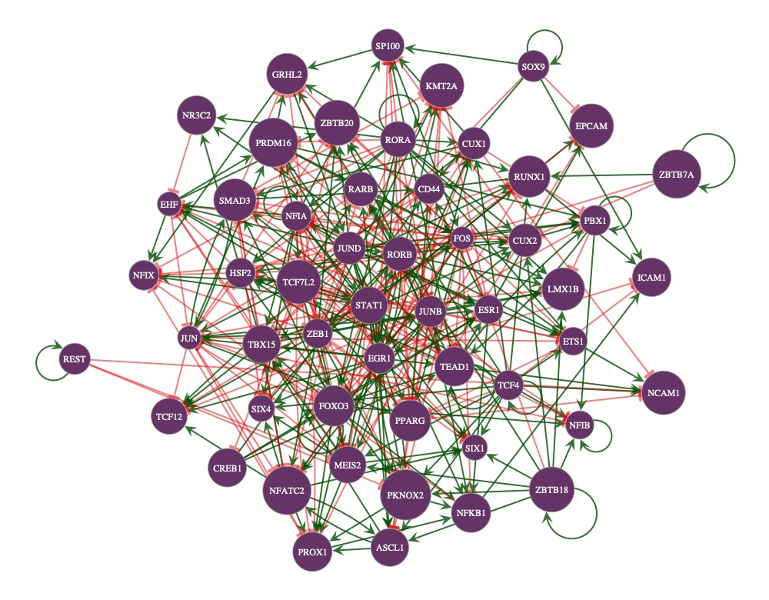
Network analysis on full dataset

Slide 16
Most of the rules fit really well on the validation dataset

